Slide 1
Displacement Ventilation

Slide 2
Displacement Ventilation
Agenda
Overview and Benefits
Common Applications
Design Considerations
Selection Process and Tools
Custom Considerations

Slide 3
Overview and Benefits

Slide 4
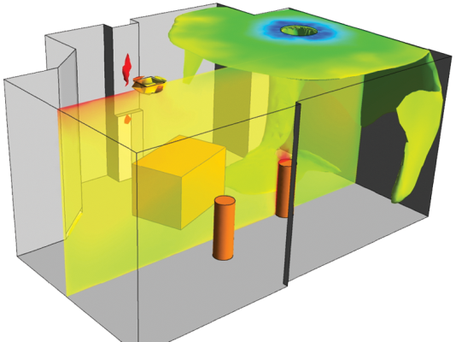
Displacement Ventilation
Overview and Benefits
Review of Mixing Systems
55ºF supply air
Mix the entire space
Diffusers drive air motion
High velocity supply

Slide 5
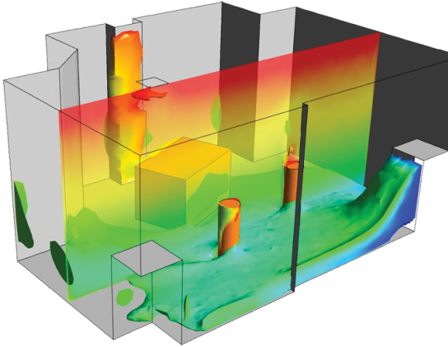
Displacement Ventilation
Overview and Benefits
Displacement Systems
65-68ºF supply air
Low velocity
No mixing in space
Heat sources drive air motion
Stratified heat, contaminants
Only conditions the occupied zone

Slide 6
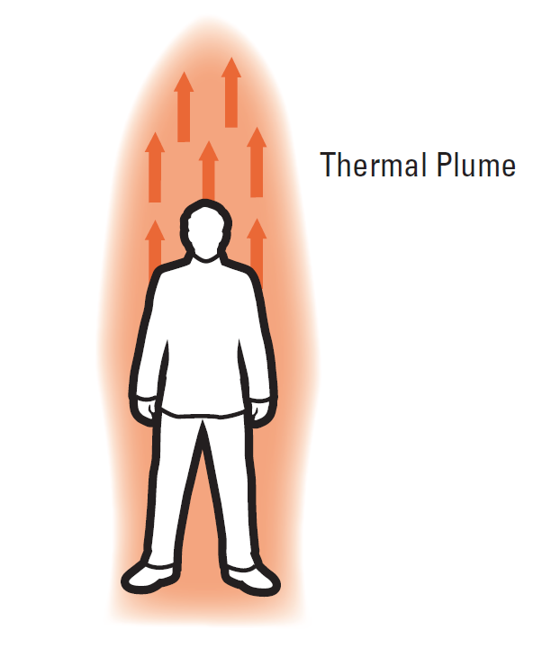
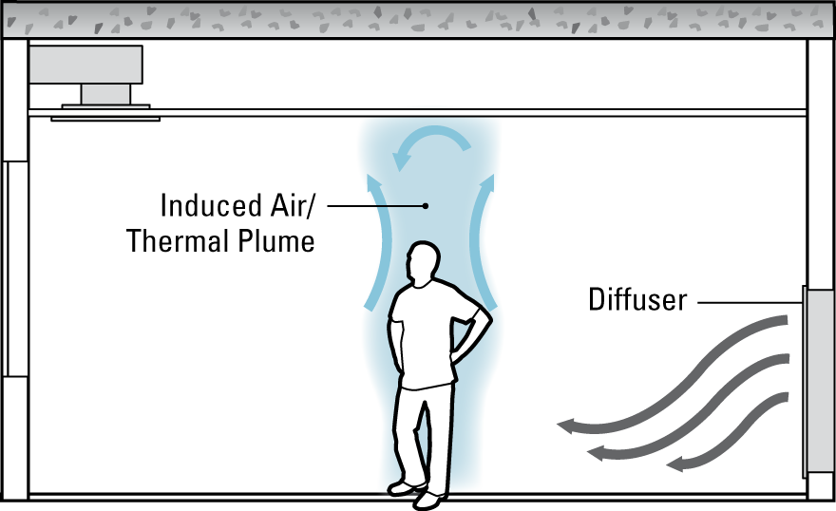
Displacement Ventilation
Overview and Benefits
How DV Works:
Thermal Plumes:
Create temperature stratification
Carry contaminants from breathing zone
Improve air quality in occupied zone

Slide 7
Displacement Ventilation
Overview and Benefits
Thermal Plumes
Heat sources drive air motion
Notes:
Diffusers no longer momentum source

Slide 8
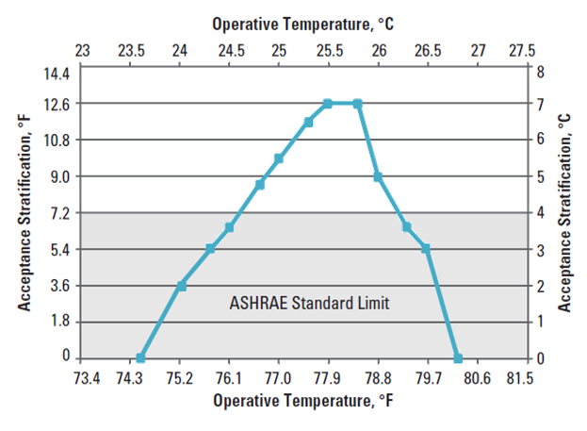
Displacement Ventilation
Overview and Benefits
Stratification – How much is comfortable?
ASHRAE 55- 7.2°F (standing) allowed
Addendum A (2013)
More is possible
Source: CBE

Slide 9
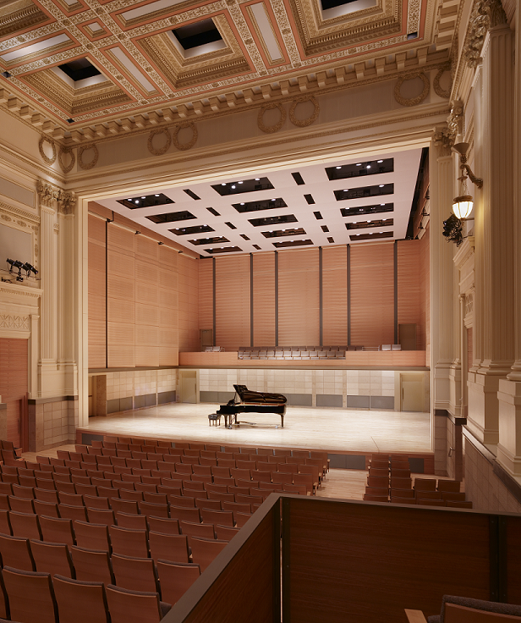
Displacement Ventilation
Overview and Benefits
Flexibility
Quiet
Indoor Air Quality
Thermal Comfort
Occupant Performance
Energy Savings
LEED and CHPS

Slide 10
Displacement Ventilation
Overview and Benefits
IEQ- Indoor Environmental Quality
Air Quality
Stratification
Thermal Comfort
Higher SAT, Lower Velocities
Acoustics
Lower velocities
Low static pressures
Notes:
Improve productivity through improvements in IEQ

Slide 11
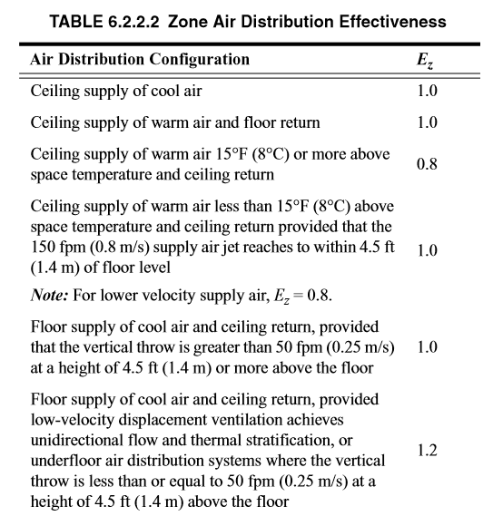
Displacement Ventilation
Overview and Benefits
Zone Air Distribution Effectiveness (E_{z})
A measure of how effectively the zone air distribution uses its supply air to maintain acceptable air quality in the breathing zone. ASHRAE 62.1.
Notes:
The air change effectiveness (ACE), is defined as the age of air that would occur throughout the room if the air was perfectly mixed, divided by the average age of air where occupants breathe. The age of air at a particular location is the average time elapsed since molecules of air at that location entered the building. Because the average age of air exiting the room is identical to the age of air that would occur throughout the room if the indoor air were perfectly mixed, the ACE is also the exhaust-air age divided by the average age of air where occupants breathe. In practical terms, the ACE equals the effective ventilation rate at the breathing zone divided by the ventilation rate that would occur throughout the building with perfect mixing and at the same outdoor air supply. A short-circuiting flow pattern between the air supply diffusers and return grilles, increases the room-air age and causes ACE to be less than unity. Perfect mixing results in an ACE of unity. Preferentially ventilating the breathing zone with outside air will cause the ACE to be greater than unity.

Slide 12
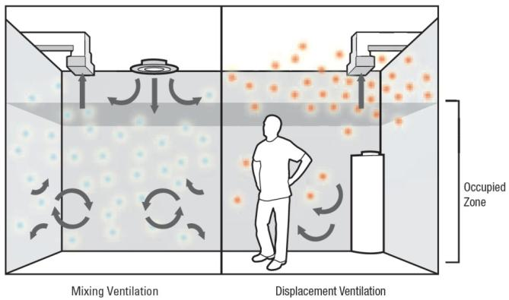
Displacement Ventilation
Overview and Benefits
E_{z} = 1.0
E_{z} = 1.2

Slide 13
Displacement Ventilation
Overview and Benefits
$$\frac{E_{zMIXING}→1.0}{E_{zDV} →1.2}=17\% Reduction$$

Slide 14
Displacement Ventilation
Overview and Benefits
Air-Change Effectiveness (ACE)
A comparison of the age of air in the occupied portions of the building to the age of air that would exist under conditions of perfect mixing of the ventilation air. ASHRAE 129-1997
From ASHRAE 62.1 2013
Notes:
The air change effectiveness (ACE), is defined as the age of air that would occur throughout the room if the air was perfectly mixed, divided by the average age of air where occupants breathe. The age of air at a particular location is the average time elapsed since molecules of air at that location entered the building. Because the average age of air exiting the room is identical to the age of air that would occur throughout the room if the indoor air were perfectly mixed, the ACE is also the exhaust-air age divided by the average age of air where occupants breathe. In practical terms, the ACE equals the effective ventilation rate at the breathing zone divided by the ventilation rate that would occur throughout the building with perfect mixing and at the same outdoor air supply. A short-circuiting flow pattern between the air supply diffusers and return grilles, increases the room-air age and causes ACE to be less than unity. Perfect mixing results in an ACE of unity. Preferentially ventilating the breathing zone with outside air will cause the ACE to be greater than unity.

Slide 15
Displacement Ventilation
Overview and Benefits
Indoor Air Quality (IAQ)
1.0 = perfectly mixed
Higher ACE with DV
Stratified contaminants
Fresh air delivered at low level
At heat source
Improvement over mixed
Source: Jung and Zeller, 2005.
Notes:
The air change effectiveness (ACE), is defined as the age of air that would occur throughout the room if the air was perfectly mixed, divided by the average age of air where occupants breathe. The age of air at a particular location is the average time elapsed since molecules of air at that location entered the building. Because the average age of air exiting the room is identical to the age of air that would occur throughout the room if the indoor air were perfectly mixed, the ACE is also the exhaust-air age divided by the average age of air where occupants breathe. In practical terms, the ACE equals the effective ventilation rate at the breathing zone divided by the ventilation rate that would occur throughout the building with perfect mixing and at the same outdoor air supply. A short-circuiting flow pattern between the air supply diffusers and return grilles, increases the room-air age and causes ACE to be less than unity. Perfect mixing results in an ACE of unity. Preferentially ventilating the breathing zone with outside air will cause the ACE to be greater than unity.

Slide 16
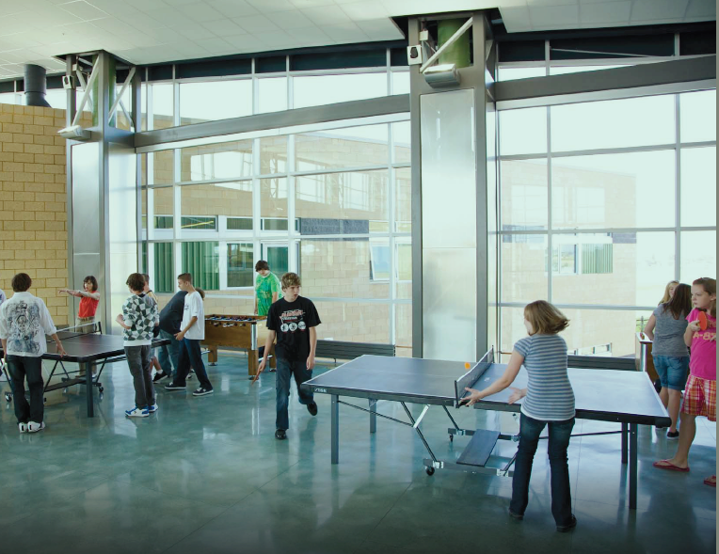
Displacement Ventilation
Overview and Benefits
Benefits of increased IAQ
Occupant health
Decreased absenteeism
Staff retention
Student/employee performance

Slide 17
Displacement Ventilation
Overview and Benefits
CHPS
Focuses on occupant health and reducing operating costs
Preferred air distribution method
Awards up to 4 points for the use of DV

Slide 18
Displacement Ventilation
Overview and Benefits

Slide 19
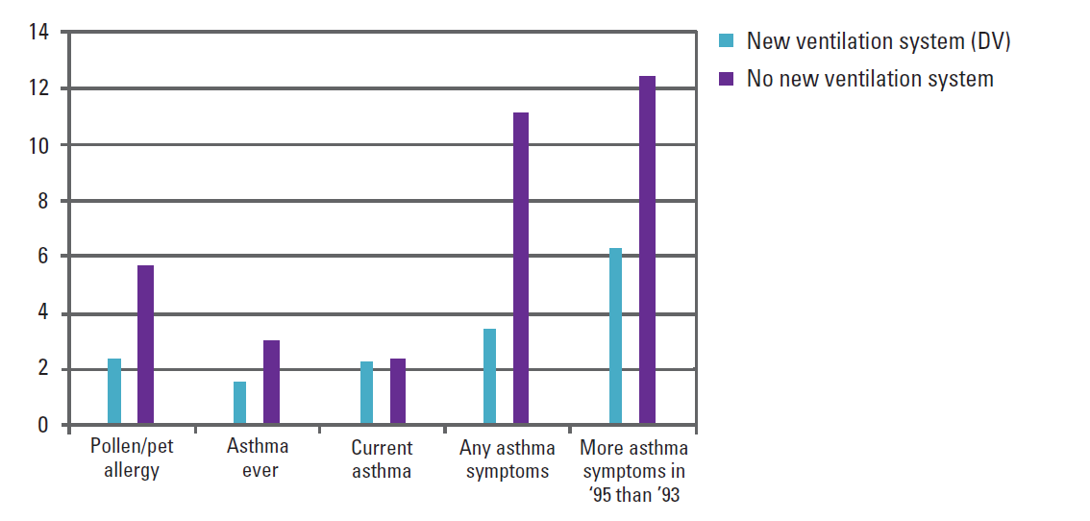
Displacement Ventilation
Overview and Benefits
Two-year study of symptoms in students
69% reduction in asthmatic symptoms in schools with new DV
Study performed in 39 schools -12 schools implemented new DV systems
Number of Incidents
Source: Smedje and Norback, 2000

Slide 20
Displacement Ventilation
Overview and Benefits
Majority of focus on building design is energy savings, however:
Energy accounts for less than 10% of average owner operating cost
1% productivity increase equivalent to 18% energy savings
Focus on creating comfortable environments

Slide 21
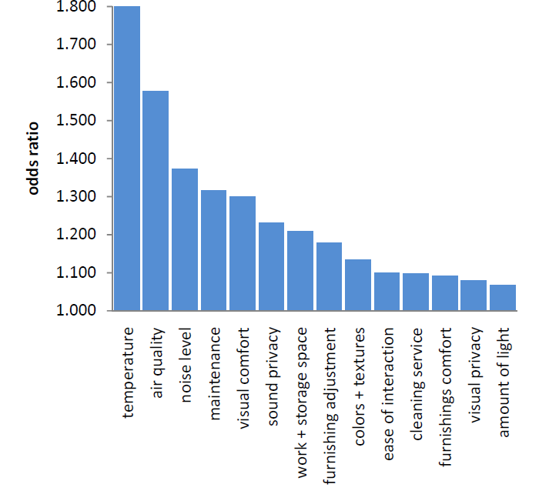
Displacement Ventilation
Overview and Benefits
Productivity
CBE’s Occupant Survey Database
Over 16,000 people
119 buildings
DV systems can help improve largest influencing factors for occupant productivity
Source: CBE, Productivity and IEQ Satisfaction

Slide 22
Displacement Ventilation
Overview and Benefits
Productivity
CBE’s Occupant Survey Database
Over 16,000 people
119 buildings
DV systems can help improve largest influencing factors for occupant productivity
Top 3
Source: CBE, Productivity and IEQ Satisfaction

Slide 23
Applications

Slide 24
Education
Happy valley middle school

Slide 25
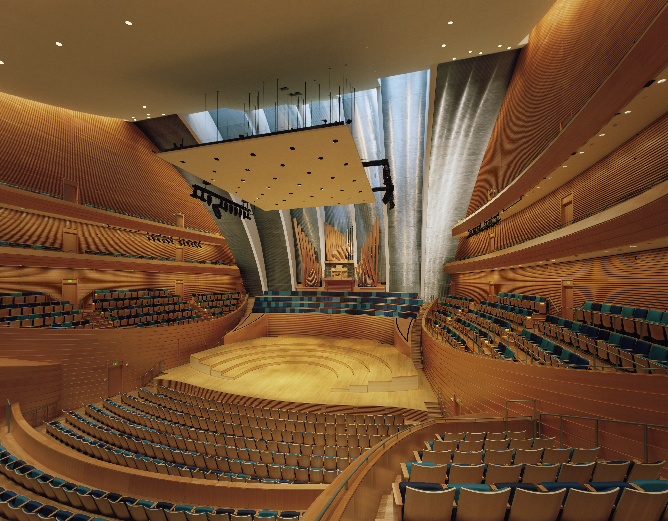
AUDITORIUMS
Kauffman center

Slide 26
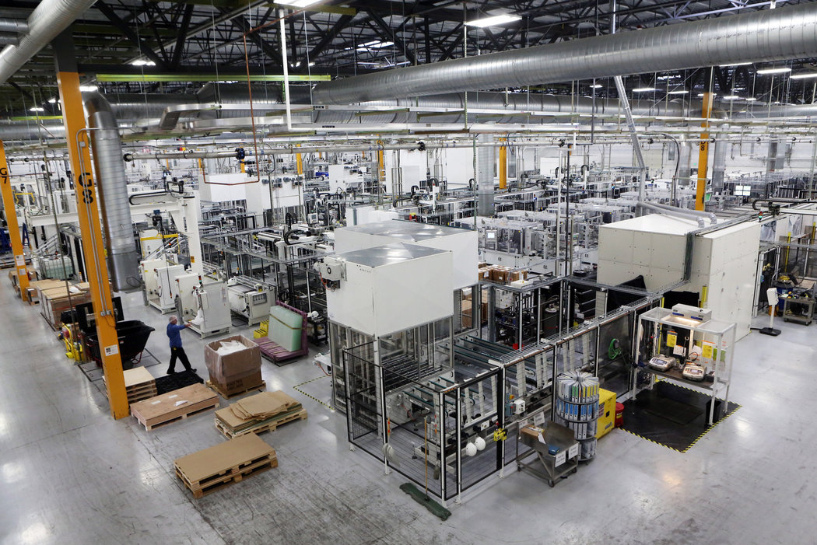
INDUSTRIAL
SOLAR WINDS PLANT

Slide 27
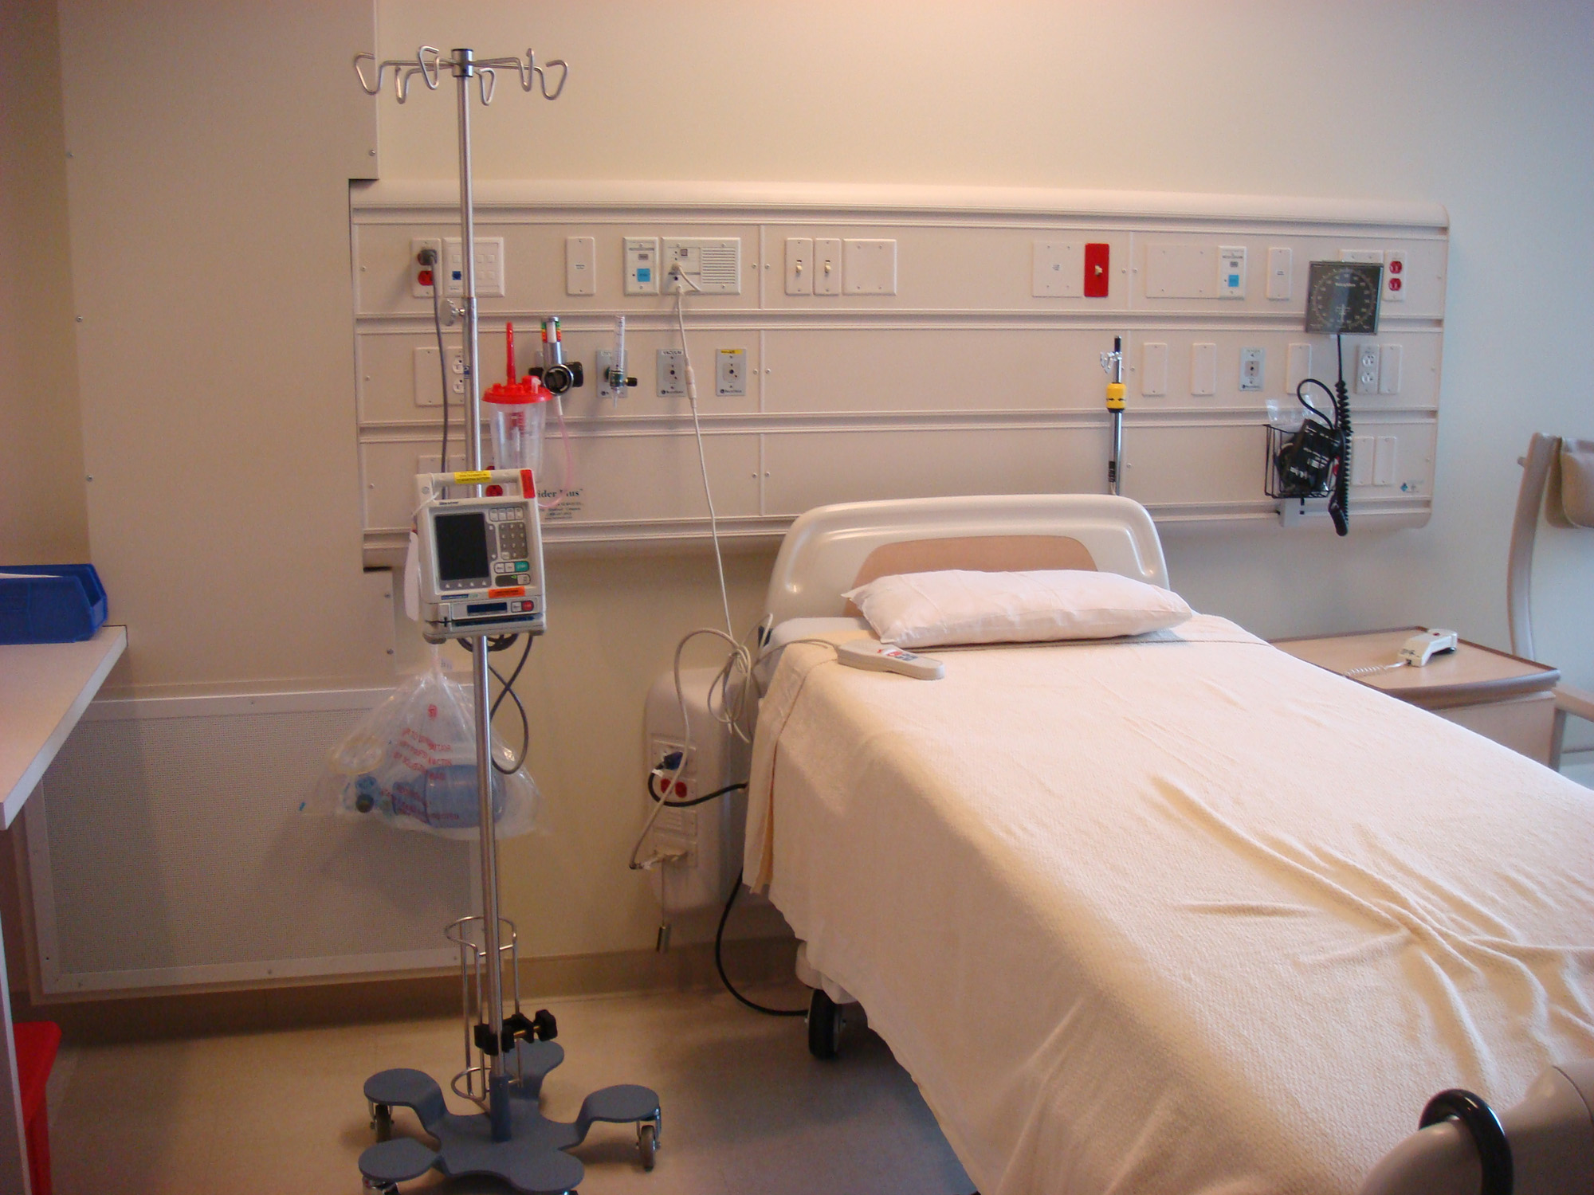
HEALTHCARE
KAISER MODESTO

Slide 28
airports
San Francisco t2

Slide 29
CASINOS
EDGEWATER CASINO

Slide 30
Design Considerations

Slide 31
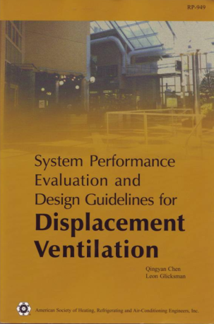
Displacement Ventilation
Design Considerations
Air Volume Calculations
Design Guide
ASHRAE research
Based on zones with approx. 9 ft. ceiling height
Calculate:
Supply Air Volume
Supply Air Temperature
Exhaust Air Temperature

Slide 32
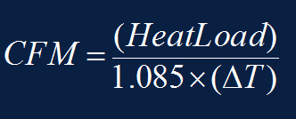
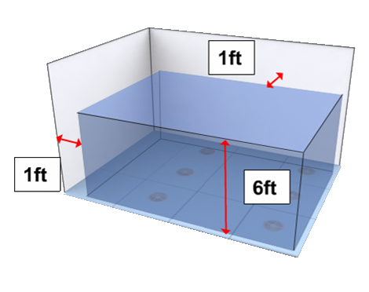
Displacement Ventilation
Design Considerations
Air Volume Calculations
Standard heat transfer equation not applicable
Assumes complete mixing
DV only conditions the occupied zone

Slide 33
Displacement Ventilation
Design Considerations
Three components of load
q_{oe} – Occupants / Equipment
q_{L} – Overhead Lighting
q_{ex} – Solar / Envelope Loads

Slide 34
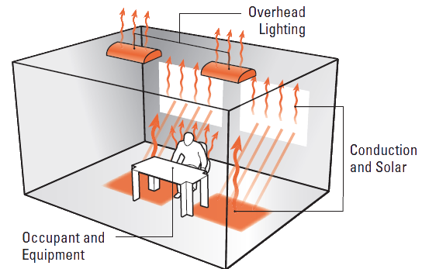
Displacement Ventilation
Design Considerations
Air Volume Calculations
For sensible loads only
Room load coefficients:
Occupants/Equipment (a_{oe}) = 0.295* q_{oe}
Overhead Lighting (a_{l}) = 0.132* q_{L}
Conduction/Radiation (a_{ex}) = 0.185* q_{ex}
Source: ASHRAE RP-949 (Chen et al. 1999)

Slide 35
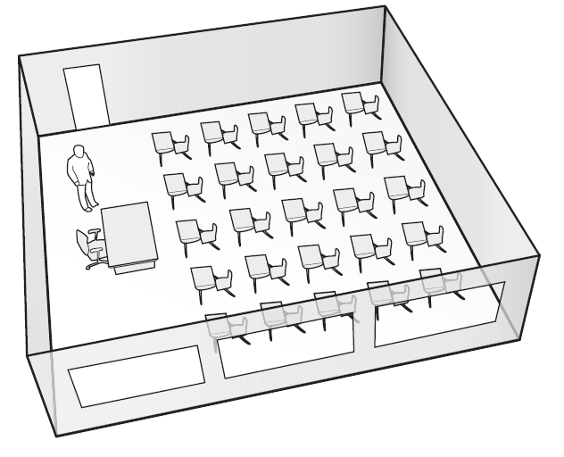
Displacement Ventilation
Design Considerations
Example space loads and qualifications
Area: 750 ft²
Room Temperature Set Point: 74ºF
Room Dimensions: 25 ft. x 30 ft. x 10 ft.
Window Area: 100 ft²

Slide 36
Displacement Ventilation
Design Considerations
Example space loads and qualifications
1 instructor
25 students
q_{o}: 26 x 250 Btu/h = 6500 Btu/h
3 computers w/ LCD monitors
q_{e}: 3 x 308 Btu/h = 924 Btu/h
T8 florescent lighting
q_{l} = 750 ft² x 6.826 Btu/h/ft² = 5120 Btu/h
q_{ex} = 300ft² x 14.6 Btu/h/ft² = 4381 Btu/h
q_{total} = 16,925 Btu/h

Slide 37
Displacement Ventilation
Design Considerations
Ventilation required by ASHRAE 62.1-2007
0.12 cfm/ft² (outdoor air)
10 cfm/person (outdoor air)
Fully Mixed
Ventilation effectiveness: Ez = .80
𝑄_{𝑜𝑧}=(𝑅_{𝑝} 𝑃_{z}+𝑅_{𝐴} 𝐴_{𝑧})/𝐸_{𝑧} =(10*26+0.12*750)/.80 = 438𝑐𝑓𝑚
Stratified (DV)
Ventilation effectiveness: E_{z} = 1.2
𝑄_{𝑜𝑧}=(𝑅_{𝑝} 𝑃_{𝑧}+𝑅_{𝐴} 𝐴_{𝑧})/𝐸_{𝑧} =(10*26+0.12*750)/1.2 = 292 𝑐𝑓𝑚

Slide 38
Displacement Ventilation
Design Considerations
Airflow required by ASHRAE 62.1-2007
Q_{mix load} =q_{OE}+ q_{L} +q_{EX} /60𝜌c_{p}∆t
=16925/(1.08)(74–55)=824 cfm

Slide 39
Displacement Ventilation
Design Considerations
Airflow calculations for DV
Q_{DV}=(0.295*7424+0.132*5120+0.185*4381)/60(0.075)(0.24)7.2
Q_{DV}= 473cfm
473 cfm vs. 824 cfm for cooling
43% reduction in air volume
33% reduction in outdoor air
 | Displacement Systems | Overhead / VRF System
Outdoor Air | 292cfm | 438cfm
Cooling Air | 473cfm | 824cfm

Slide 40
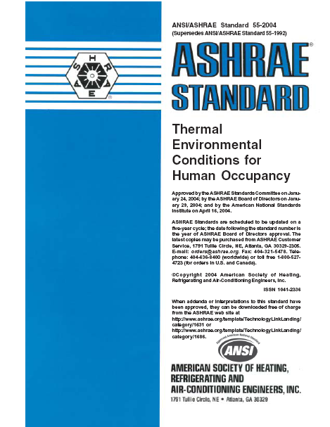
Displacement Ventilation
Design Considerations
Performance Data:
Influences selection and layout
Standards:
Adjacent zone (Nordtest)
Draft Rate (DR)- ASHRAE 55-2004 & ISO 7730
Standard Effect Temperature (SET)- ASHRAE 55-2010

Slide 41
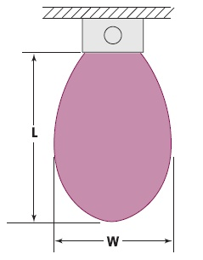
Displacement Ventilation
Design Considerations
Adjacent Zone
What does it mean?
Measured at 1” (Nordtest) or 4” above the floor in which the air velocity is at least 40 fpm
Defines velocity profile of diffuser
What is an acceptable adjacent zone length?
Shorter or longer?
Shorter means lower air quality
Longer means lower comfort
No defined acceptable range

Slide 42
Displacement Ventilation
Design Considerations
Draft Rate (DR)
Comfort based metric
ASHRAE 55-2004
ISO 7730-2005
Predicts the percentage of people dissatisfied due to draft based on:
Air Velocity
Air Temperature
Turbulence Intensity
Defined limits:
DR<20% acceptable
>20% DR
<20% DR Comfort Zone

Slide 43
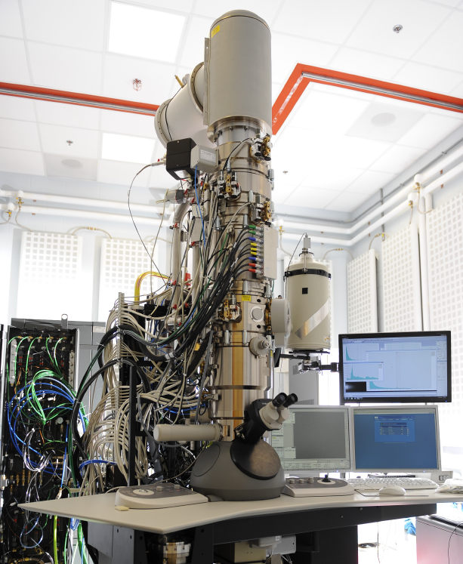
Displacement Ventilation
Design Considerations
Face velocities
Face velocity (~40 fpm)
No throw, drop, collision, etc. to consider
Low noise
Low pressure drop

Slide 44
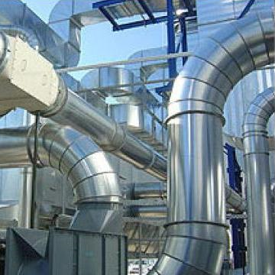
Displacement Ventilation
Design Considerations
Duct sizing
Similar to conventional system
Limit inlet to 1000 fpm
Increased face area, reduced face velocity

Slide 45
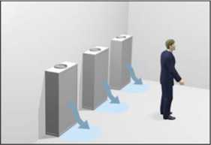
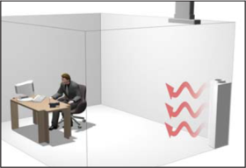
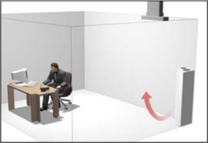
Displacement Ventilation
Design Considerations
Heating with Displacement
2-10ºF Cooling
0-5ºF Heating
5ºF+ Heating

Slide 46
Diffuser Selection Process

Slide 47
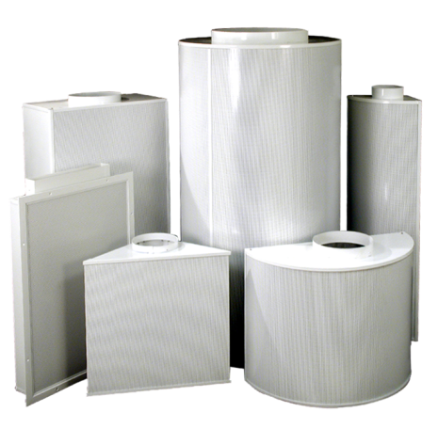
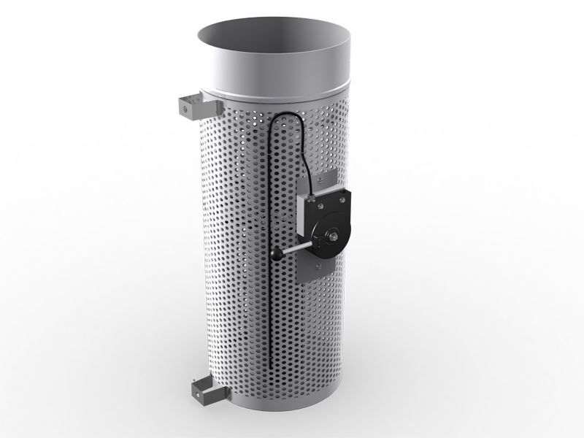
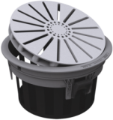
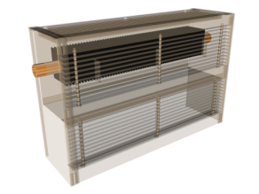
Displacement Ventilation
Diffuser Selection Process
Steps to Selecting Displacement Diffuser
Determine total square footage of diffuser required
Face velocity for 40fpm
Inlet sized for ~800fpm inlet velocity
Determine type(s) of diffuser
Where will diffuser be installed?
Determine if any customization is required
Color
Size
Install method

Slide 48
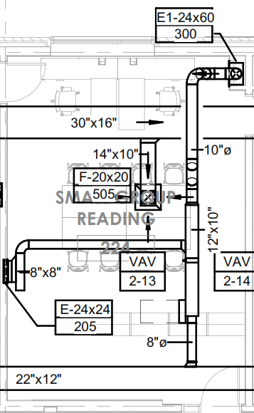
Displacement Ventilation
Diffuser Selection Process
Determine size of diffuser
Face velocity for 40fpm
Inlet sized for ~800fpm inlet velocity
Determine type(s) of diffuser
Where will diffuser be installed?
Determine if any customization is required
Color
Size
Install method

Slide 49
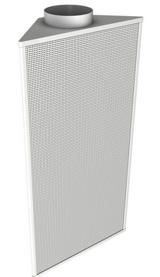
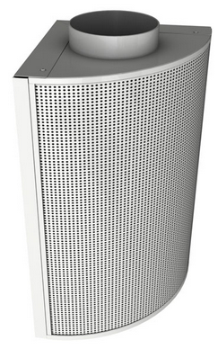
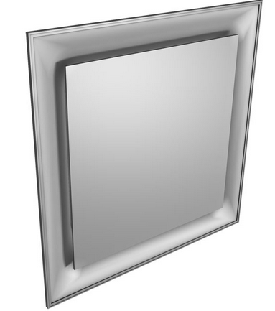
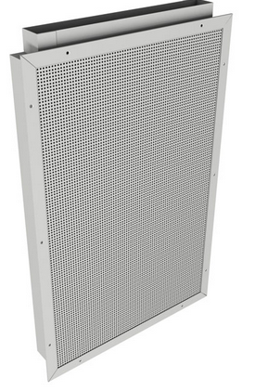
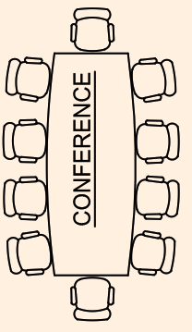
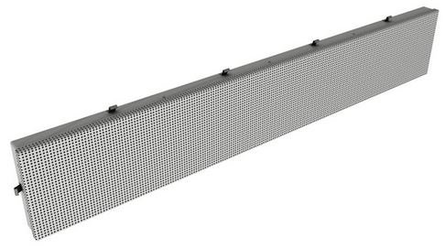
Displacement Ventilation
Diffuser Selection Process– Example
Conference Room requires 216CFM
Square footage of diffuser required:
Minimum inlet size of diffuser:
Type of Diffuser:
Mixing
Airflow: 277 CFM
Diffuser:
24” x 24“ SPD
5.4 sqft
2.5” x 15”
Notes:
150cfm -200cfm per Sq diffuser
23 x 36 DFW

Slide 50
Displacement Ventilation
Overhead Displacement vs Sidewall Displacement
Overhead Displacement
Familiar/easy install
Standard heat/cool switchover option
Ideal in spaces with limited wall space
Ideal in wide open spaces
Location of diffusers critical to minimize draft
Sidewall Displacement
More complex install and more duct work required
Standard cooling only
Limited by the wall space available
Higher flexibility with location of diffusers

Slide 51
Diffuser Selection Process Custom Considerations

Slide 52
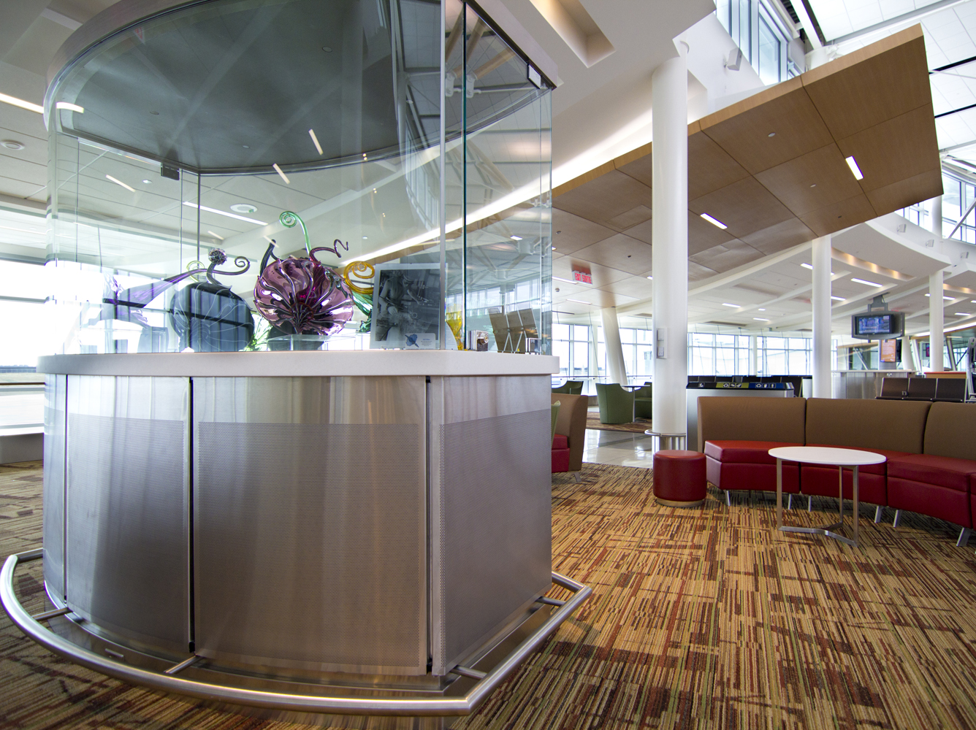
Displacement Ventilation
Custom Considerations
Wide variety of Price standard displacement diffusers
Wall / ceiling mounted
Floor mounted
Heat / cool models
Industrial models

Slide 53
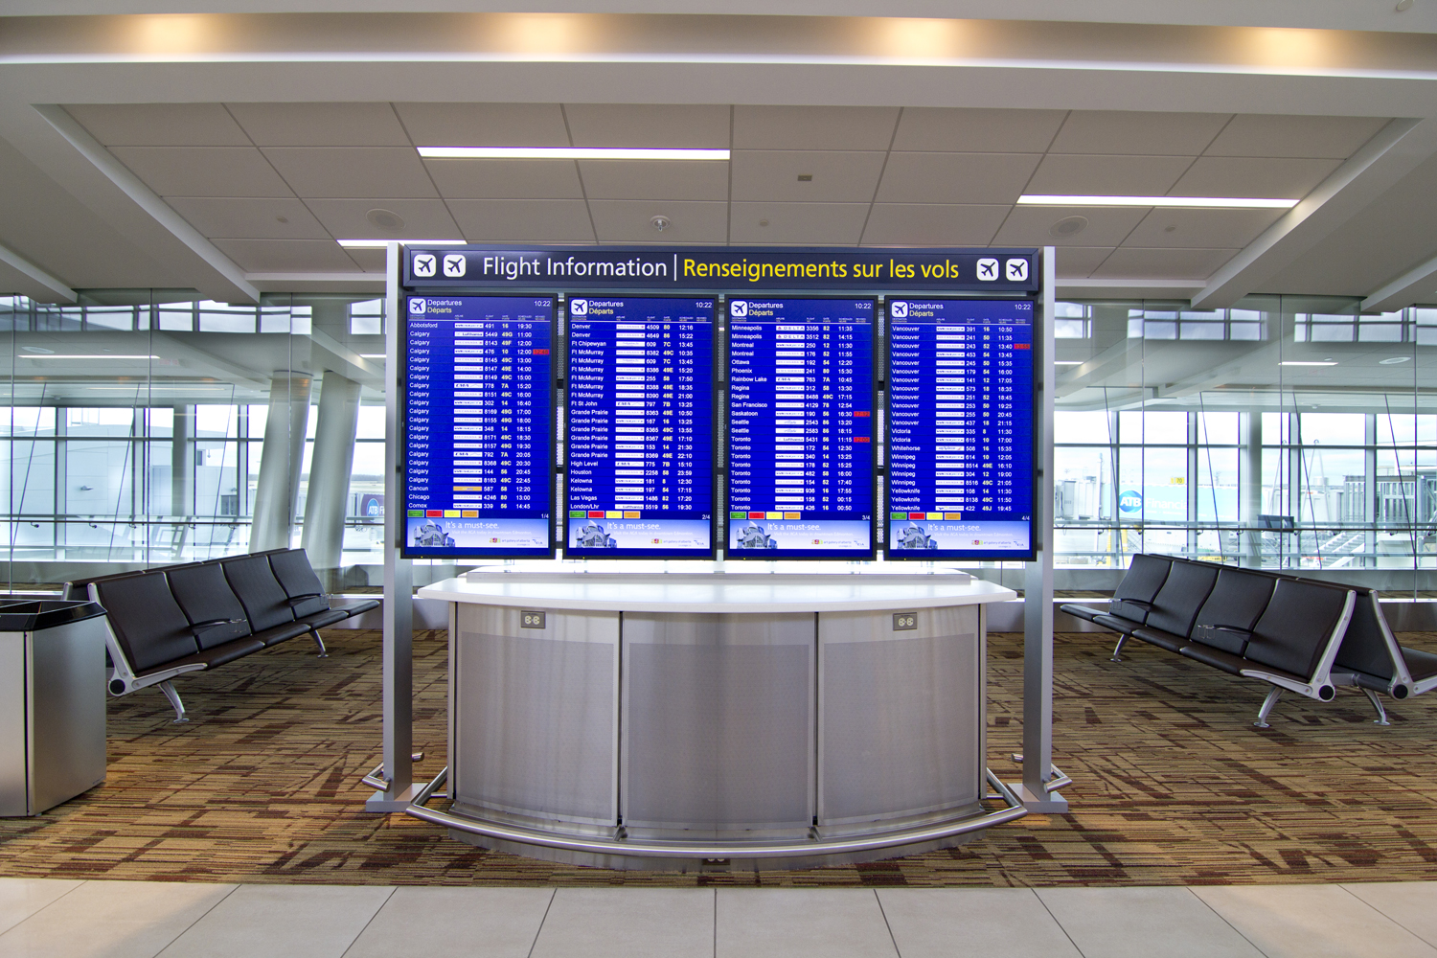
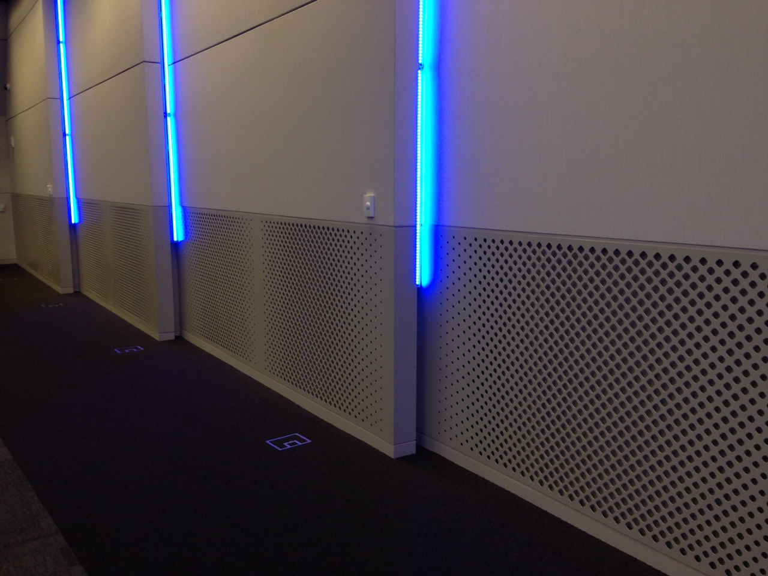
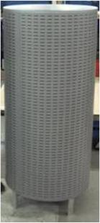
Displacement Ventilation
Custom Considerations
Custom Diffuser Options
Color
Size
Material
Architectural integration
Perforation pattern
Fastening system

Slide 54
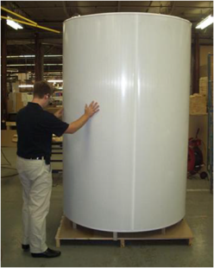
Displacement Ventilation
Custom Considerations
Information to provide for most Common Specials
Color
Provide RAL color or color chip sample (preferred)
Oversized units
Inlet dimensions to minimize noise (< 1000fpm)
DFR with Plenum
Specify plenum depth and inlet size
Curved diffusers
Specify the length of arc
Specify the radius of curvature

Slide 55
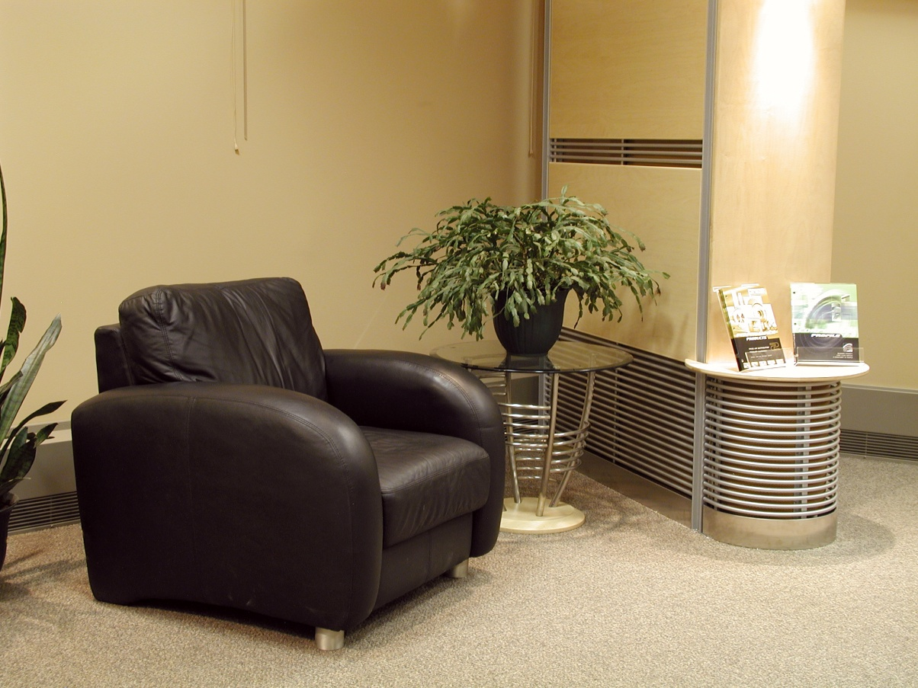
Displacement Ventilation
Custom Considerations

Slide 56
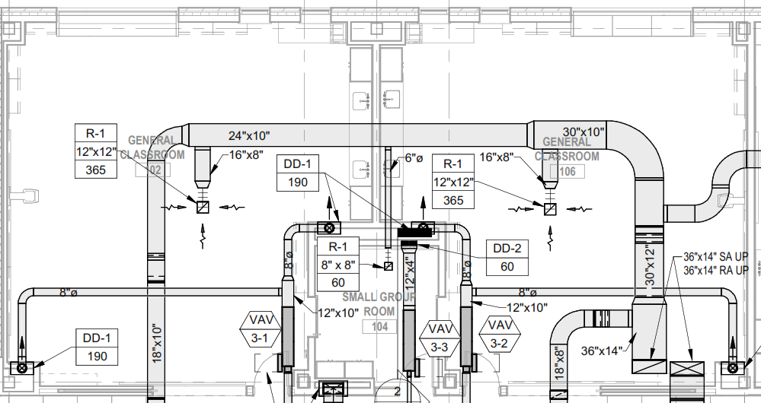
Displacement Ventilation
Selection Process
Steps to Selecting Displacement Diffuser
Determine the size of diffuser required
Typically sized for 40fpm
Inlet sized for ~800fpm inlet velocity
Determine type(s) of diffuser
Where will diffuser be installed?
Determine if any customization is required
Color
Size
Install method

Slide 57
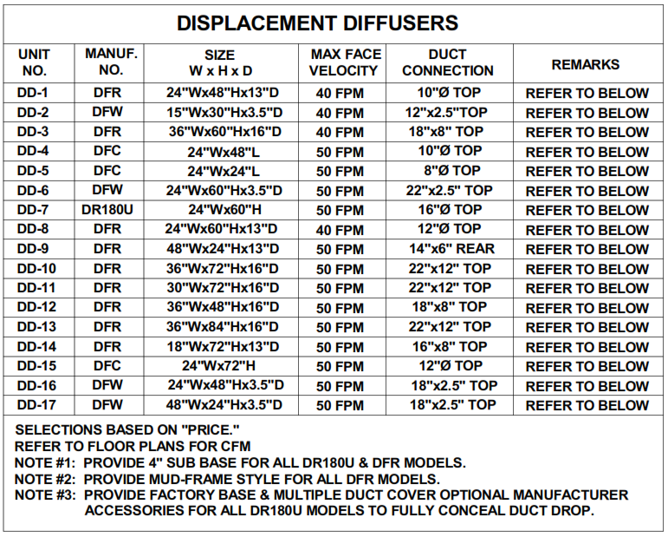
Displacement Ventilation
Custom Considerations

Slide 58
Displacement Ventilation
High Performance School Microsite
https://pricevm.com/schools

Slide 59
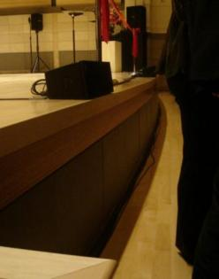
Displacement Ventilation
Products
Curved Diffusers

Slide 60
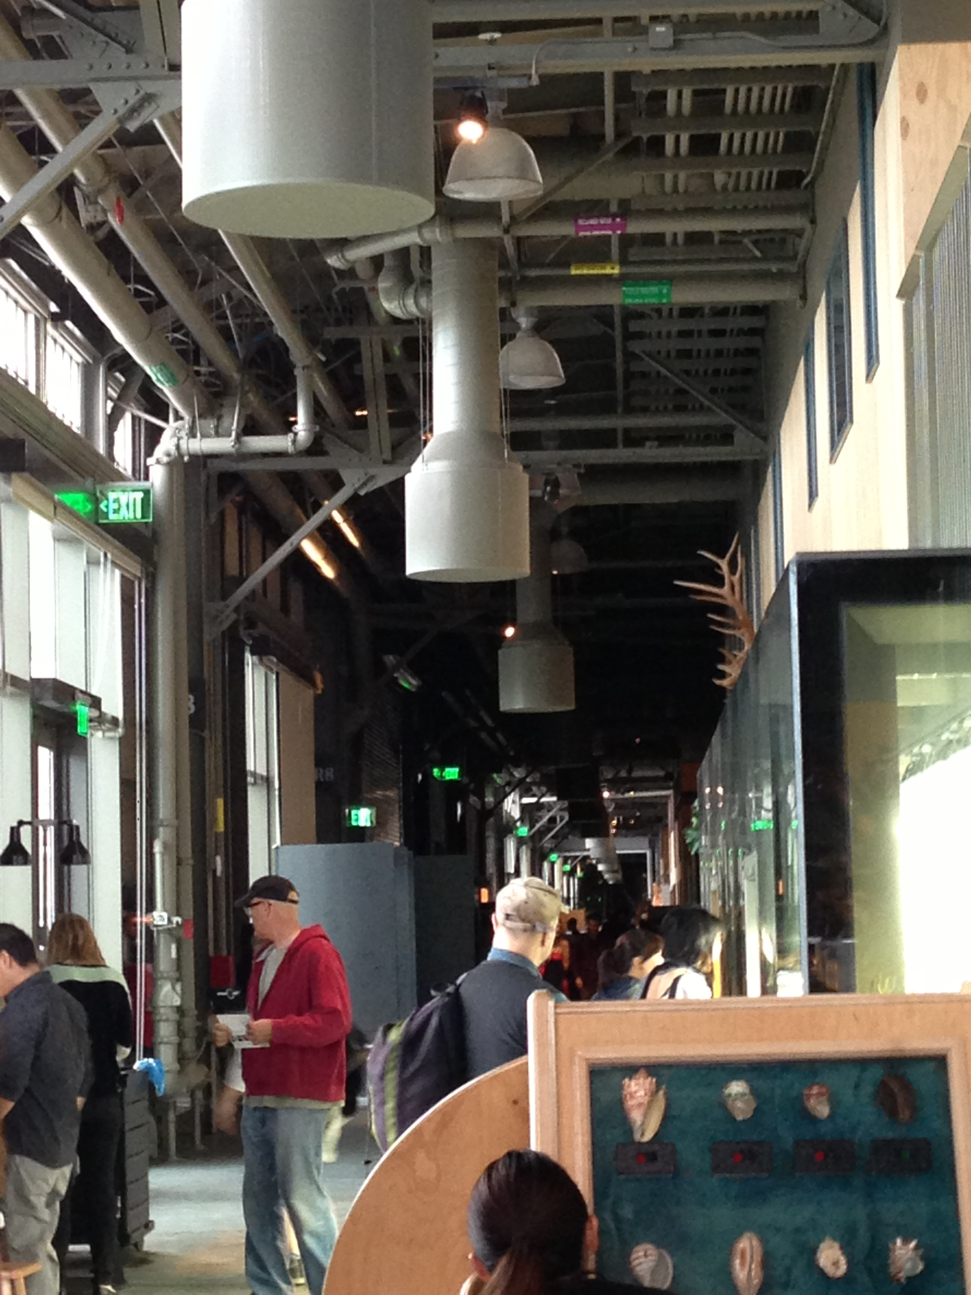
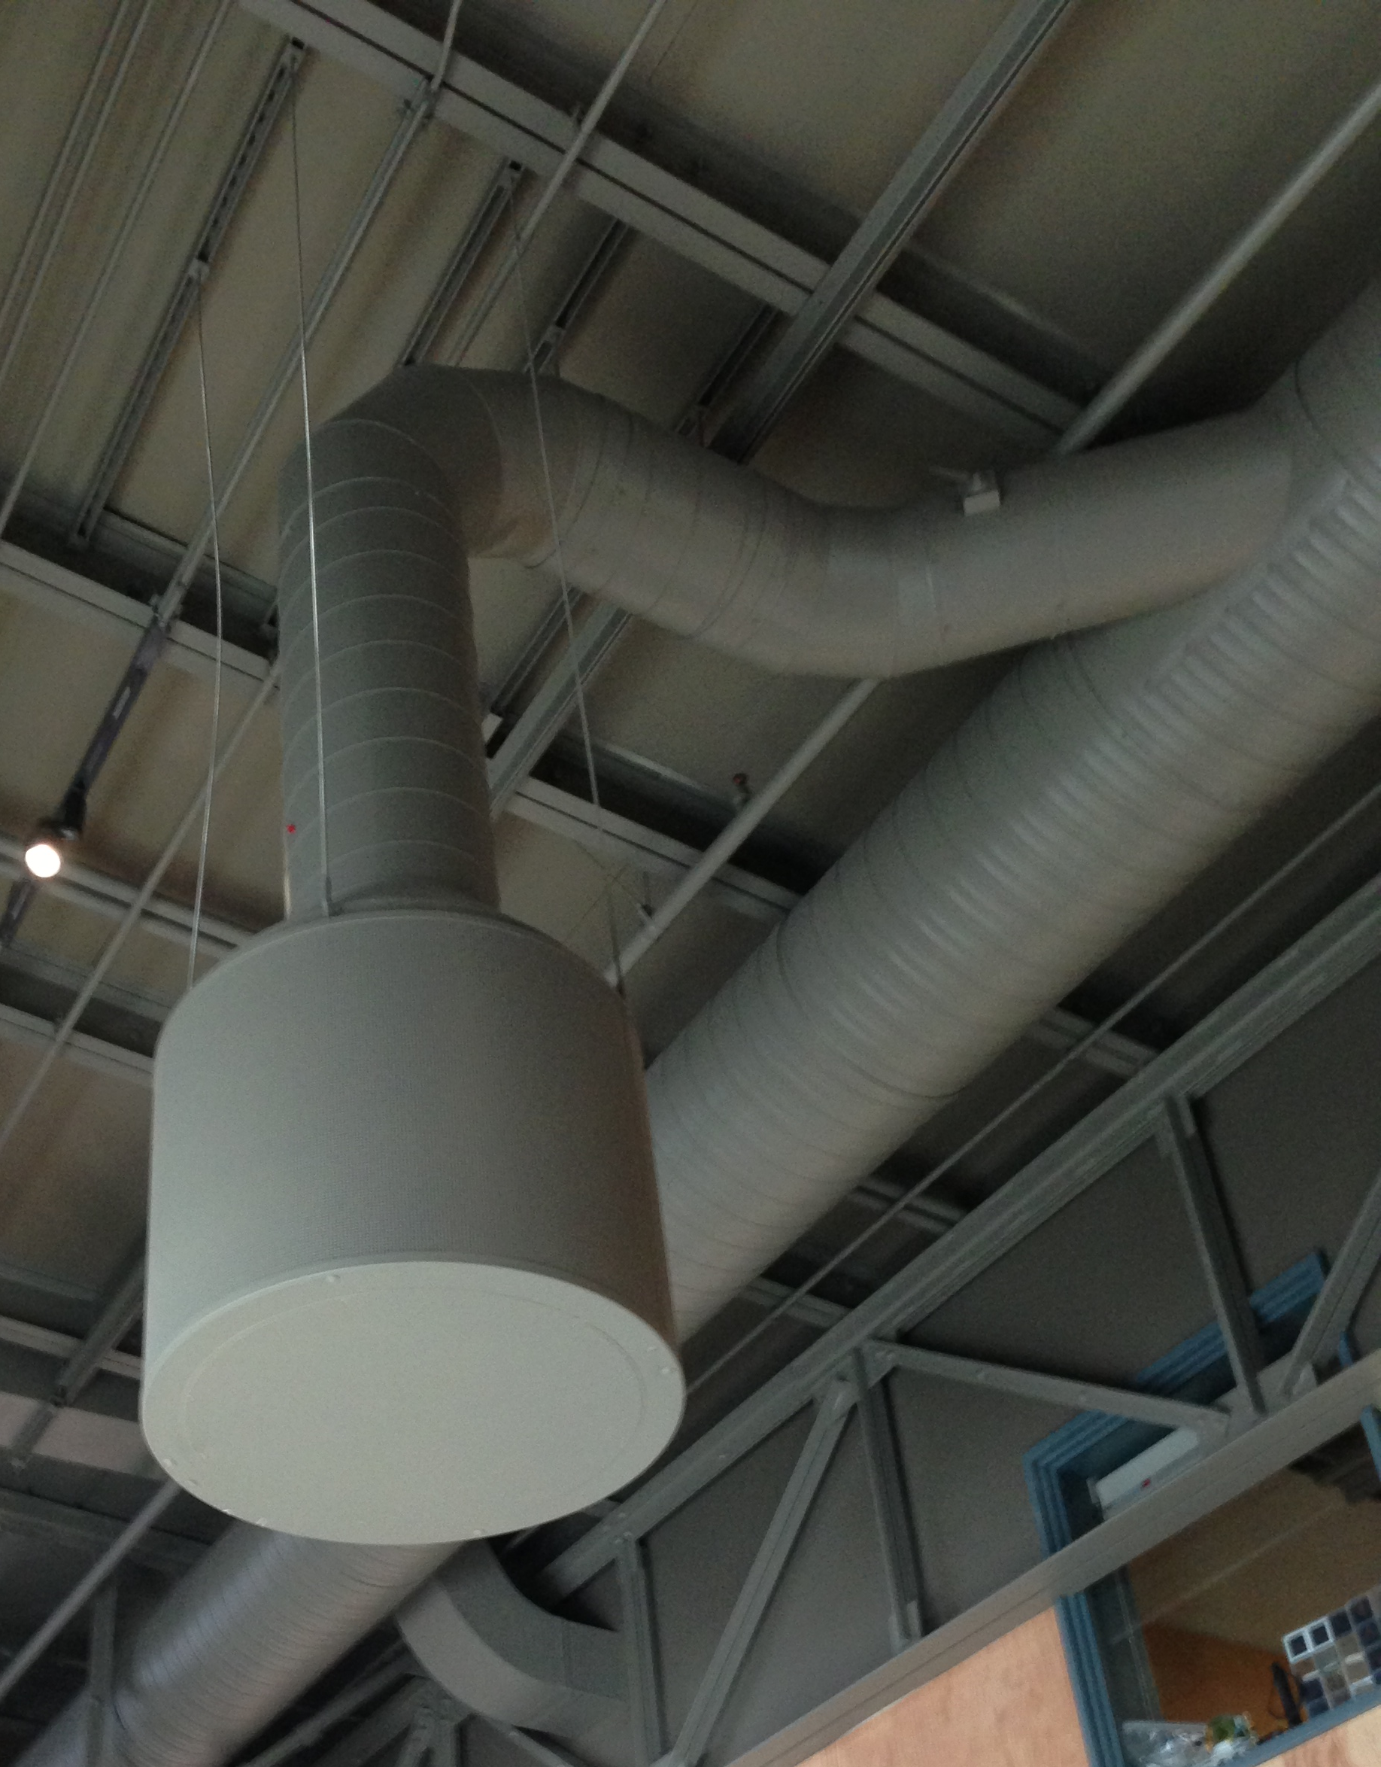
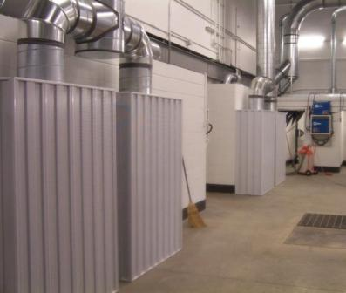
Displacement Ventilation
Products
Installation examples
DR360-DH
DR360-DH

Slide 61
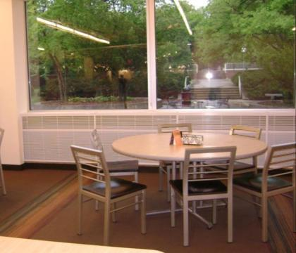
Displacement Ventilation
Products
Installation examples
DLE-H
Lunchroom / cafeteria
DLE-H
Office

Slide 62
Displacement Ventilation
Products
Custom diffuser highlights
Custom column wrapped DR180
DR360 with custom hinged face and electrical integration
Notes:
The custom DR180’s in this school cafeteria are also used as a base for a condiment/napkin stand. As you can see, the kids are seated very close to the diffusers – a great example of the high thermal comf

Slide 63
Displacement Ventilation
Products
DFGL
DFGL

Slide 64
Displacement Ventilation
Products
Custom curved DFW with heat/cool
DFW with custom size, perforation, color, and fasteners

Slide 65
Concourse features custom diffusers integrated into the wall and 360° flow diffusers

Slide 66
Displacement Ventilation
Vancouver International Airport
Displacement Ventilation in International Terminal

Slide 67
Gerald Ford International AP
Grand Rapids, MI

Slide 68
San Francisco airport T2
Architect: Gensler
Engineer: SJ Engineers

Slide 69
Custom geometries and finishes were used to integrate diffusers into the aesthetics of the terminal. Here, the diffuser is located in the right hand corner of the back wall

Slide 70
Displacement diffusers are hidden within the bases of arrival/departure boards, display cases, and counters
Notes:
Stainless steel diffusers with a custom face. Curved. Price worked closely with design team on this job – went very smoothly.

Slide 71
Displacement diffusers are hidden within the bases of arrival/departure boards, display cases, and counters

Slide 72
Displacement Ventilation Questions?

Slide 73
Displacement Ventilation
Design Support
https://www.priceindustries.com/software/room-designer/

Slide 74
Displacement Ventilation
Design Support
Price Room Designer Software
Complete load calculations in Trace
Use basic mixing module
Input peak sensible loads into software
Latent load conditioned at AHU
Determine air volume for DV

Slide 75
Displacement Ventilation
Design Support
Computational Fluid Dynamics
Simulates system performance
Variety of data outputs
Temperature
Velocity
Thermal comfort
IAQ
System optimization

Slide 76
Displacement Ventilation
Design Support
Verify system performance
Simulate working conditions
Hot/cold wall
Adjustable ceiling height
Raised floor
Can be used in conjunction with CFD modeling
Church Retrofit Mock-up
Classroom Mock-up

Slide 77
Questions?

